Slide 1

The Promise of Focused ACT (FACT) for Unique and Diverse Populations: Increasing Access to Health for All
A Symposium for Association of Contextual Behavioral Science 2020

Slide 2

Questions, Comments
Carla is providing technical support –
Thank you, Carla!
Use the chat box on the screen that you used to join this presentation
At the beginning of your question, indicate the name of the presenter you are directing your question to
Example: ”Dr. Barreto, how many….”

Slide 3
Overview
Presenters will share findings related to the promise of FACT for improving health outcomes for a variety of patients in a variety of treatment settings.
Dr. Barreto will describe a protocol for delivering a single-session of ACT for health-related behavior change and provide a case example.
Dr. Gaynor will describe results of two studies examining the efficacy of the single-session ACT protocol with collegians
Dr. Kanzler will present data from a pilot randomized controlled trial assessing the impact of a 4-session FACT group visit for primary care patients with chronic pain.

Slide 4
Overview
Dr. Ogbeide will share results of a case study evaluation of use of FACT with a suicidal primary care patient.
Dr. Robinson will describe clinical and health equity findings from a primary care demonstration project that investigated the impact of placing FACT trained behavioral health providers in general practice clinics in New Zealand.

Slide 5
Objectives
After attending, participants will be able to
  Describe healthcare settings that improve patient access to FACT for people of all ages, races, and ethnicities
  List three examples of improved health outcomes associated with brief FACT visits
  Apply ideas about methods to the design of feasibility studies in their communities

Slide 6
A Single-Session of Acceptance and Commitment Therapy for Health-Related Behavior Change: Protocol Description and Case Example
Monica Barreto, PhD
Assistant Professor
Clinical Child Psychology
Yale Child Study Center
New Haven , CT monica.barreto@yale.edu

Slide 7
Common areas of concern:
Population health (Fine et al., 2004; Liu et al., 2013).
The CDC identifies certain behaviors as primary risk factors for chronic illness:
Lack of physical activity
Poor nutrition
Poor sleep
Alcohol and Substance use
Changing lifestyle behaviors can help improve overall wellness and prevent chronic illness
Short-term and long-term implications
Financial, health, social, academic, self-esteem, quality of life
Notes:
The Centers for Disease Control and Prevention have identified physical activity, nutrition, and sleep as three key health-related behaviors that can help the prevention of chronic disease.
The rates of chronic disease are continuously rising, impacting approximately 117 million people as of 2012.
According CDC, chronic disease in America is the leading cause of death and disability, impacting 6 in 10 adults, as of this year
The treatment of chronic diseases accounts for 86% of our nation’s health care costs
Specifically, the U.S. spends $147 billion on obesity-related health care costs each year, and $117 billion on inadequate physical activity (CDC, 2019).
Changing lifestyle behaviors can help improve overall wellness and quality of life, as well as prevent chronic health conditions.
Sleep is proposed to have a restorative function. thus, improving one’s quality of sleep is expected to promote positive health outcomes.

Slide 8
Changes in mental health delivery to target population health problems
Clinical requirements for intervention
  Time-limited
  Evidence-based
  Potential applicability in consultation format
  Potential applicability for use in primary care settings
Notes:
As providers of mental health services, we do our best to assist people in improving their quality of life. The way we provide such services is changing….
the world of health care is continuously changing, community mental health agencies and managed behavioral health organizations are requiring clinicians to
treat their clients using fewer sessions but doing so without compromising the individual’s outcomes,
what the field of psychology needs is an evidence-based approach to human behavior change that allows clinicians to provide their clients with the same treatment principles within a broad range of problems but in a simple, consolidated, uniform manner. It is hypothesized that Focused Acceptance and Commitment Therapy (FACT) is this form of treatment model

Slide 9
Psychological Explanation (Lillis et al., 2009)
Health related interventions have struggled with long-term maintenance
This may be a result of lack of attention paid to the psychological factors
  i.e. Distress tolerance, emotion regulation
Previous studies support the connection between psychological constructs and health-related behavior change.
  Acceptance-based coping strategies and psychological flexibility have been found to mediate behavior change in weight maintenance
Notes:
Research focused on improving long-term weight maintenance, has lead to the investigation of the psychological factors involved in health-related behavior changes.
Lillis, et al. (2009) suggest that part of the problem may be the lack of attention given to the psychological variables involved in such behavior goals.

Slide 10
Acceptance & Commitment Therapy (ACT) (Harris, 2009)
Focuses on identifying thoughts and feelings that act as obstacles to engaging in action towards values
Goal of ACT is NOT to change how an individual is trying to problem solve BUT focuses:
  Connection with personal values
  Engaging in committed actions
  Regaining a desired quality of life
  Decreasing attempts to control thoughts & emotions.
Effective stand-alone treatment as well as in combination with other treatment approaches.
Notes:
Research suggests that ACT is an effective treatment for anxiety disorders, psychosis, chronic pain, depression, substance abuse, and more.
Research data has also indicated higher client satisfaction rates and lower rates of drop out compared to other treatments (Stoddard & Afari, 2014).

Slide 11
Matrix (Polk & Schoendorf, 2014)

Slide 12

LET’S BEGIN!
What do you want to control, avoid, or get rid of?
What have you tried?
How has it worked?
What has it cost you?
What kind of life would you choose if you could choose?
What are your values?
How would we know that you’re moving towards your values?

Slide 13
BEHAVIORAL BARRIERS (Polk & Schoendorf, 2014)
Things that others can observe!
  Things we DO
Examples:
  Access to healthy foods
  Busy schedule
  Travel
  Meal prep or lack there of
  Budget

Slide 14
INTERNAL BARRIERS (Polk & Schoendorf, 2014)
What are we thinking or feeling?
  These may be the hardest ones…
    or ones we try to push away!
Examples:
  “ I can’t do this”
  “I deserve …”
  “I feel/look horrible”
  “This is too hard”
  “I’ll never lose weight”

Slide 16
DEFUSION (Hayes et al., 1999)
Fusion means getting caught up in our thoughts
  Allowing them to dominate our behavior.
Defusion means separating or distancing from our thoughts
Letting them come and go instead of being caught up in them.
TOOLS
  “I’m Having the Thought…”
  “Lemon, Lemon, Lemon…”

Slide 17
ACCEPTANCE (Hayes et al., 1999), (Harris, 2009)
Mindfulness exercise
Breathe
Expand
Allow
Objectify
Normalize
Expand Awareness
Notes:
Now we’re going to kick off with a long mindfulness exercise, which is constructed from eight different techniques strung together: observe, breathe, expand, allow, objectify, normalize, show self- compassion, and expand awareness. Afterward I’ll unpack it. As usual, I’d like you to read it out loud as if talking to a client. (However, I recognize you may not wish to do this if you’re in a library!) The ellipses indicate brief pauses of one to three seconds. (Also, please note: with my clients, and throughout this book, I use the words “feelings” and “emotions” interchangeably.)
OBSERVE
Therapist:
I invite you to sit upright in your chair with your back straight and your feet flat on the floor. Most people find they feel more alert and awake sitting this way, so check it out and see if this is the case for you. And either close your eyes or fix them on a spot, whichever you prefer. And take a few slow, deep breaths, and really notice the breath flowing in and out of your lungs. (Pause 10 seconds.) Now quickly scan your body from head to toe, starting at your scalp and moving downward. And notice the sensations you can feel in your head ... throat ... neck ... shoulders ... chest ... abdomen ... arms ... hands ... legs ... and feet. Now zoom in on the part of your body where you’re feeling this feeling most intensely. And observe the feeling closely, as if you’re a curious scientist who has never encountered anything like this before. (Pause 5 seconds.) Observe the sensation carefully ... Let your thoughts come and go like passing cars, and keep your attention on the feeling ... Notice where it starts and where it stops ... Learn as much about it as you can ... If you drew an outline around it, what shape would it have? ... Is it on the surface of the body or inside you, or both? ... How far inside you does it go? ... Where is it most intense? ... Where is it weakest? (Pause 5 seconds.) If you drift off into your thoughts, as soon as you realize it, come back and focus on the sensation ... Observe it with curiosity ... How is it different in the center than around the edges? Is there any pulsation or vibration within it? ... Is it light or heavy? ... Moving or still? ...What is its temperature? ... Are there hot spots or cold spots? ... Notice the different elements within it ... Notice that it’s not just one sensation—there are sensations within sensations ... Notice the different layers. (Pause 5 seconds.)
BREATHE
Therapist:
As you’re observing this feeling, breathe into it ... Imagine your breath flowing into and around this feeling ... Breathing into and around it ...
EXPAND
Therapist:
And as you’re breathing into it, it’s as if, in some magical way, all this space opens up inside you ... You open up around this feeling ... Make space for it ... Expand around it ... However, you make sense of that ... Breathing into it and opening up around it ...
ALLOW
Therapist:
And see if you can just allow this feeling to be there. You don’t have to like it or want it ... Just allow it ... Just let it be ... Observe it, breathe into it, open up around it, and allow it to be as it is. (Pause 10 seconds.) You may feel a strong urge to fight with it or push it away. If so, just acknowledge the urge is there without acting on it. And continue observing the sensation. (Pause 5 seconds.) Don’t try to get rid of it or alter it. If it changes by itself, that’s okay. If it doesn’t change, that’s okay too. Changing or getting rid of it is not the goal. Your aim is simply to allow it ... to let it to be. (Pause 5 seconds.)
OBJECTIFY
Therapist:
Imagine this feeling is an object ... As an object, what shape does it have? ... Is it liquid, solid, or gaseous? ... Is it moving or still? ... What color is it? ... Transparent or opaque? ... If you could touch the surface, what would it feel like? ... Wet or dry? ... Rough or smooth? ... Hot or cold? ... Soft or hard? (Pause 10 seconds.) Observe this object curiously, breathe into it, and open up around it ... You don’t have to like it or want it. Just allow it ... and notice that you are bigger than this object, ... no matter how big it gets, it can never get bigger than you. (Pause 10 seconds.)
NORMALIZE
Therapist:
This feeling tells you some valuable information ... It tells you that you’re a normal human being with a heart ... it tells you that you care ... that there are things in life that matter to you ... And this is what humans feel when there’s a gap between what we want and what we’ve got ... The bigger the gap, the bigger the feeling. (Pause 5 seconds.)
Therapist:
Take one of your hands and place it on this part of your body ... imagine that this is a healing hand ... the hand of a loving friend or parent or nurse ... and feel the warmth flowing from your hand into your body ... not to get rid of the feeling but to make room for it ... to soften up and loosen up around it. (Pause 10 seconds.) Hold it gently, as if it’s a crying baby or a frightened puppy. (Pause 10 seconds.) And letting your hand fall, once again breathe into the feeling and expand around it. (Pause 10 seconds.)
EXPAND AWARENESS
Therapist:
Life is like a stage show ... and on that stage, are all your thoughts, and all your feelings, and everything that you can see, hear, touch, taste, and smell ... and for the last few minutes, we dimmed the lights on the stage, and we shined a spotlight on this feeling ... and now it’s time to bring up the rest of the lights ... So, bring up the lights on your body ... notice your arms and legs and head and neck ... and notice that you’re in control of your arms and legs, regardless of what you’re feeling ... Just move them around a little to check that out for yourself ... and now take a stretch, and notice yourself stretching ... and bring up the lights on the room around you ... Open your eyes, look around, and notice what you can see ... and notice what you can hear... and notice that there’s not just a feeling here ... there’s a feeling inside a body, inside a room, inside a world full of opportunity ... and welcome back!

Slide 19
ACTION PLAN (Polk & Schoendorf, 2014)
24-hour goal
Week goal
30-day goal

Slide 20
COMMIT!
What are you about TODAY?
Who will YOU BE 30 days from now?

Slide 21
Case Example: P112 (Barreto & Gaynor ,2018)
19-year-old, African American male
Target domain: Nutrition

Slide 22
Matrix (Barreto & Gaynor, 2018)

Slide 23
Commitment Statement (Barreto & Gaynor, 2018)

Slide 24
Case Example: Results
Breakfast:
  Pre-session: 0 days
  30 days: 22-24 days
Fast food:
  Pre-session: 4-6 days
  30 days: 0 days
*P112 reported his exercise and sleep also showed changed in the 30 days following the ACT session.
Strenuous exercise: Moderate exercise:
  Pre-session: 1-3 days. Pre-session: 0 days
  30-days: 10-12 days 30-days: 10-12 days
Sleep (7+ hours):
  Pre-session: 7-9 days
  30-days: 13-15 days
Confidence (Likert scale 0-10):
  Pre-session: 6
  Post-session: 10
Amount of calories (Out of 30 days):
  Pre-session: 7-9 days
  30-days: 25–27 days
Fruit servings:
  Pre-session: 1-3 days
  30-days: 10-12 days
Vegetable servings:
  Pre-session: 1-3 days
  30-days: 13-15 days

Slide 25
Future Directions
  Upcoming pilot study will examine the effects of ACT as a brief intervention for diabetes-related distress and self-management in adolescents with T1D within Yale New Haven Hospital’s Pediatric Diabetes Clinic.
  ACT session will be adapted from the one session ACT protocol used in the Barreto et al. (2019) and Barreto & Gaynor (2018) studies.

Slide 26
A Single-Session of ACT for Health-Related Behavior Change: Results of an Open Clinical Trial and Randomized Controlled Trial with Collegians
Scott T. Gaynor, PhD Monica Barreto, PhD
Professor Assistant Professor
Western Michigan University Yale Child Study Center scott.gaynor@wmich.edu monica.barreto@yale.edu

Slide 27

A Values-Based Research Agenda
Value – health & wellness
Ultimate Goal – impact population health
Proximal goal – develop and evaluate a single-session ACT protocol
https://www.digitalhealth.net/2019/07/advisory-series-population-health-management-2/

Slide 28
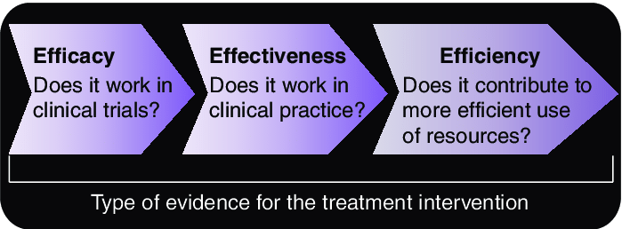
A Progressive Research Plan
Feasibility
Efficacy
Effectiveness
Efficiency
(Lam & Annemans, 2007)

Slide 29


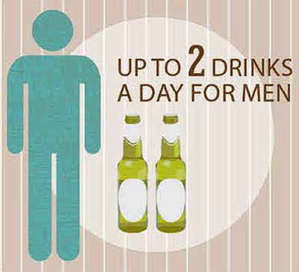
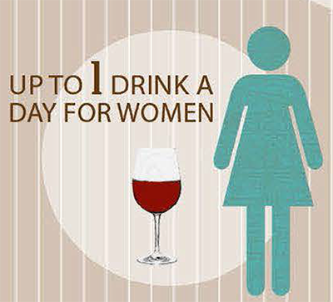


Targeting Health-Related Behaviors
Physical activity, nutrition, sleep, and alcohol & tobacco use are key health-related behaviors for chronic disease prevention (Liu et al., 2016).
Problematic behavior patterns are apparent in collegian samples (American College Health Association, 2015)

Slide 30
ACT vs. A Matched Comparison Group (MCG)
39 participants received a single 60-min ACT session (Barreto & Gaynor, 2018)
  M age = 20.64 (2.68), 92% female
Focused on 1 health-related target
Completed a 30-day follow-up

Slide 31
Health-Related Behavior Survey (HRBS)
Self-report of tobacco, alcohol use, exercise, eating habits, and sleep over the past 30 days on an 11-point Likert scale (ranging from 0 days to 28–30 days) taken before session and at 30 days
Higher scores indicate more days engaging in healthy behaviors
Basic psychometrics, including 30-day test-retest, established in a sample of 210 collegians.
39 matched comparisons selected from psychometric sample based on closest target domain score, gender, age, and ethno-racial identification

Slide 32
ACT outperformed MCG
2×2 ANOVA time x condition effect: F = 11.77, p = .001
d (30 days) = .68 (medium-large)
Avg. increase of 4.3 days of healthy behavior in ACT vs .93 days in MCG

Slide 33
ACT outperformed MCG

Slide 34
ACT vs. Information Only Waitlist Controls (IOWL)
45 collegians
  M age = 22.35 (6.91), 78% female
Randomized to
  ACT session (n = 22)
  Information-only waitlist control (n = 23)
    Brief handouts offering nutrition, exercise, or
    sleep recommendations
HRBS before session and at 30 days

Slide 36
ACT outperformed IOWL
  2 x 2 ANOVA time x condition effect: F = 4.63, p = .04
  d (30 days) = .51 (medium)
  Avg. increase of 5 days of healthy behavior in ACT vs 1.6 days in IOWL

Slide 37
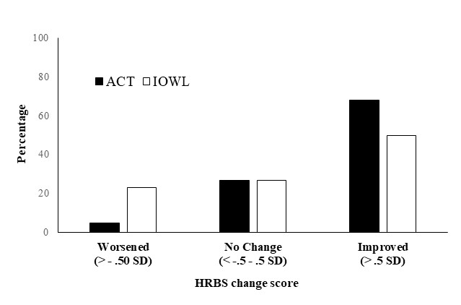
ACT outperformed IOWL

Slide 38
Discussion
The data support the plausibility of using a single, focused ACT session to address common health-related concerns.
Developing brief, flexible, focused interventions are particularly important for primary care and other integrated medical settings

Slide 39



Limitations
Self-report data
Motivated, relatively healthy, volunteer participants
Predominantly (white) females
Short-term changes

Slide 40
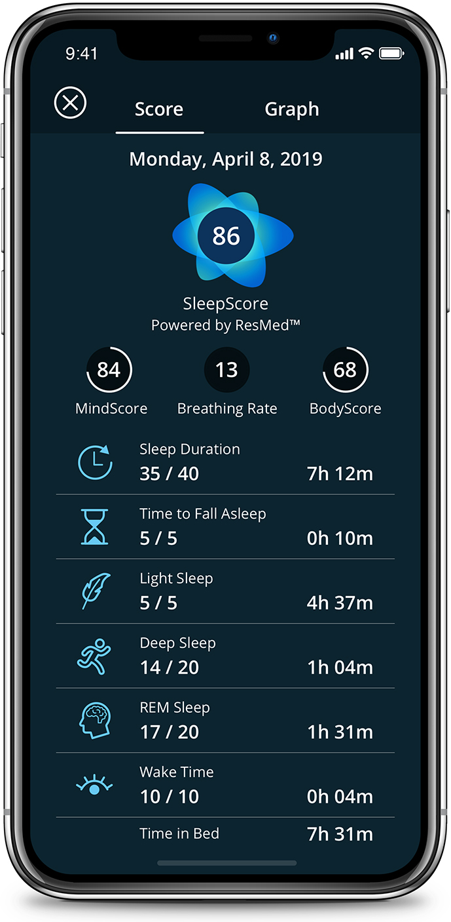

Future Directions
Better measurement
  Repeated measures - daily report data via Google Docs
  Objective measures
    Sleep Score App
    GEMS Activity Tracker
    Body Mass Index
    2-minute walk test (Bohannon et al., 2015)

Slide 41
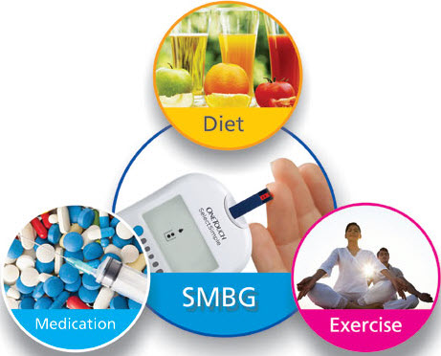
Future Directions
Evaluation in clinical settings
  Yale – New Haven Hospital Diabetes Clinic
    Target – increasing self-management in adolescents with T1D

Slide 42
Thank you
ACBS attendees
Blue Cross Blue Shield of Michigan (Grant SAP 002390)

Slide 43
References
American College Health Association (2015). American college health association-national college health assessment II: Undergraduate student reference group executive summary, spring 2015. Hanover, MD: American College Health Association.
Barreto, M., & Gaynor, S. T. (2018). A single-session of acceptance and commitment therapy for health-related behavior change: Protocol description and initial case examples. Behavior Analysis: Research and Practice. 19, 47–59.
Barreto, M., Tran, T., & Gaynor, S.T. (2019). A Single-Session of Acceptance and Commitment Therapy for Health-Related behavior change: An Open Trial with a nonconcurrent matched comparison group. Journal of Contextual Behavioral Science, (13), 17-26.
Bohannon, R.W., Wang, Y-C, & Gershon, R.C. (2015). Two-Minute Walk Test Performance by Adults 18 to 85 Years: Normative Values, Reliability, and Responsiveness. Archives of Physical Medicine and Rehabilitation,
Liu, Y., Croft, J. B., Wheaton, A. G., Kanny, D., Cunningham, T. J., Lu, H., et al. (2016). Clustering of five health-related behaviors for chronic disease prevention among adults, United States, 2013. Preventing Chronic Disease, 13, 160054. https://doi.org/10.5888/pcd13.160054.

Slide 44

Focused Acceptance & Commitment Therapy (FACT) for Chronic Pain in an Integrated Primary Care Clinic: Findings from a Pilot RCT
Kathryn E. Kanzler, PsyD, ABPP
Board-Certified Clinical Health Psychologist
Assistant Professor
Psychiatry & Family and Community Medicine
@DrKatieK
Notes:
Slide 34 updated

Slide 45
Summary of this pilot study…
Primary care patients liked receiving Focused ACT for persistent (chronic) pain. FACT can help people reduce physical disability, increase acceptance and engage in valued activities when delivered by an integrated behavioral health consultant.
@DrKatieK

Slide 46
Introduction
This study was supported in part by the National Center for Advancing Translational Sciences, National Institutes of Health, through Grant KL2 TR001118. The content is solely the responsibility of the authors and does not necessarily represent the official views of the NIH.
Notes:
This study is supported by a KL2 grant; I am only speaking for myself and my co-authors

Slide 47
Chronic Pain¹
Diabetes
Heart Disease
Cancer
¹ CDC. Relieving Pain in America: Blueprint for Transforming Prevention, Care, Education, and Research. 2011.
³ Dowell D, Haegerich TM, Chou R. JAMA. 2016;315(15):1624-1645.
Notes:
Persistent pain affects over 100million americans; is more prevalent than diabetes, heart disease and cancer – combined.¹

Slide 48
Chronic Pain in Primary Care
Most patients get pain care in primary care, often sub-optimal¹⁻⁵
  Half of all filled opioid prescriptions are from primary care⁶
CDC: Nonpharmacologic therapy and nonopioid pharmacologic therapy are preferred for chronic pain⁵
.
¹ Fortney L. Prim Care Rep. 2012;18(11):137-151.
2 Jamison RN, Kerry Anne Sheehan B, Elizabeth Scanlan N, Ross EL. J Opioid Manag. 2014;10(6):375-382.
3 Fink-Miller EL, Long DM, Gross RT. J Am Board Fam Med. 2014;27(5):594-601.
4 Potter M, et al. J Fam Practice. 2001;50(2):145-145.
5 Dowell D, Haegerich TM, Chou R. JAMA. 2016;315(15):1624-1645.
6 Levy B, Paulozzi L, Mack KA, Jones CM. Am J Prev Med. 2015;49(3):409-413.
Notes:
Due to lack of training, resources and frequently-prescribed opioid meds
National guidelines recommend treatment that goes beyond meds to include CBT

Slide 49
Treating Chronic Pain
Strong evidence that Acceptance & Commitment Therapy (ACT)¹ helps people with chronic pain²⁻³
Functioning
ACT
Disability
Hayes SC, Strosahl KD, Wilson KG. Guilford Press; 1999; 2011
Hann KE, McCracken LM. J Contextual Behav Sci. 2014;3(4):217-27.
Vowles KE, McCracken LM, O'Brien JZ. Behav Res Ther. 2011;49:748-55.
Notes:
ACT is associated with improvements in physical functioning, improved pain-related disability and decreases in emotional distress for patients with chronic pain regardless of changes in perceived pain intensity

Slide 50
The problem…
Specialty Care (ACT)
Primary Care¹
^{(Not so much ACT)}
Patient
Patient
Patient
Patient
Patient
How to make ACT more accessible?
¹Fortney L. Prim Care Rep. 2012;18(11):137-151.
Notes:
However, most research on ACT for chronic pain is delivered in specialty care settings, not PC – where most patients with chronic pain receive pain care

Slide 51
Getting to the Patients
Integrated Behavioral Health Consultants (BHCs)¹ may help
  BHCs are members of the primary care team
  Evidence that BHCs can deliver brief, effective, evidence-based non-pharmacologic interventions²⁻⁴
  McCracken et al. (2013) examined ACT for pain in a non-integrated primary care setting⁵
  No studies yet on ACT for pain delivered by BHCs
Feelings
Thoughts
Body
PAIN
Environment
Behavior
Robinson PJ, Reiter JT. Springer Science & Business Media; 2007 Mar 12.
Bryan CJ, Corso ML, Corso KA, Morrow CE, Kanzler KE, Ray-Sannerud B. J Consult Clin Psychol. 2012;80(3):396-403.
Ray-Sannerud BN, Dolan DC, Morrow CE, Corso KA, Kanzler KE, Corso ML, Bryan CJ. Fam Syst Health. 2012;30(1):60-71
Vogel M, Kanzler KE, Goodie J, Aikens J. J Behav Med. 2017; 40: 69-84
McCracken LM, Sato A, Taylor GJ, J of Pain 2013; 14 (11):1398-1406.
Notes:
(growing evidence that BHCs are able to deliver brief versions of evidence-based care;
Studies have found BHCs x70% improvement in global functioning (physical & mental health) after average 2.5 visits
Gains sustained for an average of 2 years

Slide 52
Aims of Pilot Study
Aim 1: To determine feasibility, acceptability and effectiveness
  Feasibility: Recruitment, Retention, Fidelity
  Acceptability: Patient/participant satisfaction with FACT
  Effectiveness: Self-reported physical disability
Aim 2: To examine mechanisms of change
  Chronic Pain Acceptance
  Values-Based Activity
Aim 3: To understand the experiences of study participants … in order to inform a larger trial
v
Pilot study to provide preliminary data informing a larger trial
Notes:
Aim 1: To determine feasibility and effectiveness
Hypothesis A: Brief Acceptance & Commitment Therapy (ACT) treatment reduces physical disability when delivered by a Behavioral Health Consultant (BHC) in primary care.
Aim 2: To examine mechanisms of change
Aim 3 To understand the experiences of study participants and the perceived benefits of the intervention in order to inform a larger trial and prepare for future implementation efforts.

Slide 53
Study Design & Methods
@DrKatieK
Notes:
3 min

Slide 54
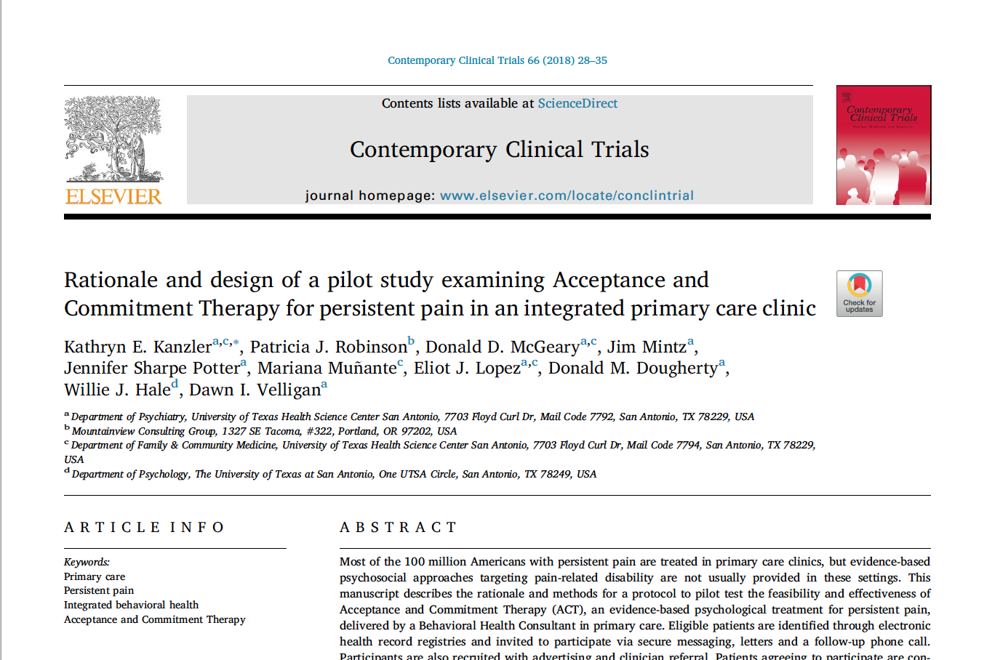

Slide 55
Setting
Southwestern U.S.
Primary care clinic in community
Affiliated with academic medical center
~6000 patients enrolled

Slide 56
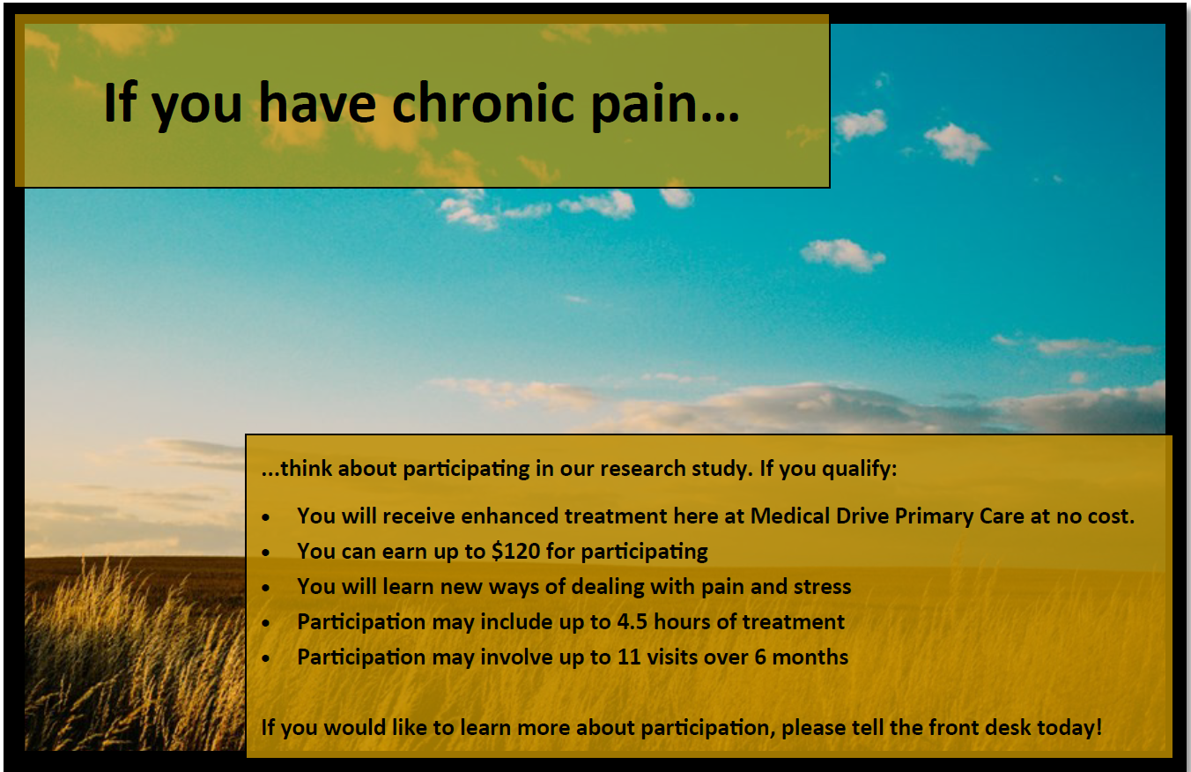
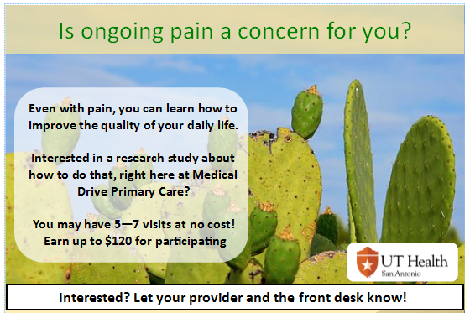
- Adults age 18+
- Non-cancer pain 12 wks+ in duration
- Current PCP at study clinic
-In treatment for pain
- Medical contraindications
- Inability to comprehend or participate
-Psychosis, delirium, intoxication
-Social anxiety/ unwillingness to participate
Notes:
Inclusion/Exclusion criteria along with advertisements; We have broad inclusion criteria to improve external validity and enhance applicability of findings to real-world patient settings.
Setting: San Antonio, TX; Patient Centered Medical Home (NCQA-II); 4 (now 8) PCPs
INCLUSION: Adults age 18+; Non-cancer pain 12 wks+ in duration; Current PCP at study clinic; seeking treatment
EXCLUSION: - Medical contraindications, Inability to comprehend/participate, psychosis, delirium, intoxication

Slide 57
Recruitment: Ads, Secure msgs, Calls
Screening / Enrollment
Baseline Assessment
Stratified Randomization
Active + Standard of Care
Control (Enhanced Primary Care)
Kanzler KE, Robinson PJ, McGeary DD, Mintz J, Potter JS, Muñante M, …Velligan DI. Contemporary clinical trials. 66:28-35, 2018
Notes:
Here are the stages in our study Already established Integrated BH program; ID pts many ways; We chose to stratify based on pain severity to reduce a potential confounding variable

Slide 58

Control (Enhanced Primary Care)
Education:
Pacing
Education:
Sleep
Education:
Relaxation
Education:
Goals
Patient-Centered
Interview
Week 1
Week 2
Assessments
Week 3
Assessments
Week 4
Assessments
Week 12
Assessments
Week 24
Assessments
Patient-Centered
Interview
BHC Visit
ACT Class
ACT Class
ACT Class
ACT Class
Booster
Active + Primary Care
Notes:
ACT delivered by this PI (interventionist) – used manual that Patti Robinson & I developed; *also she did fidelity checks* handouts on standard CBT – no overlap
Focus on Values
Identification of/commitment to
Reduce avoidance coping
Decrease unhelpful pain control strategies
Build awareness
Practice mindfulness skills
Engage in life
Set meaningful goals
→ How to live life in a meaningful way (even with pain)

Slide 59
Assessments
Primary Outcome
Physical Disability: Oswestry Disability Index (modified; ODI)¹
Mechanistic Outcomes
Acceptance: Chronic Pain Acceptance Questionnaire-Revised (CPAQ)²
Values-based activity: Chronic Pain Values Inventory (CPVI)³
Measures of Feasibility & Acceptability:
Satisfaction: Survey/Interview (at least 80%)
Fidelity ratings: ~10% of audio recordings reviewed by external consultant
Retention: fewer than 25% drop out
Recruitment: at least 80% of goal (N=60)
Fairbank JC, Couper J, Davies JB, O'Brien JP. Physiotherapy. 1980;66(8):271-3.
2. McCracken LM, Vowles KE, Eccleston C. Pain. 2004;107(1-2):159-66.
3. McCracken LM, Yang SY. Pain. 2006;123(1-2):137-45.
Notes:
Standardized & validated self-report measures…
The Oswestry Disability Index (ODI)[5] is a 10-item self-report scale that assesses perceived disability and functional impairment across a range of daily activities.
Chronic Pain Acceptance Questionnaire-Revised 20-item is used to determine effects of treatment on overall pain acceptance.
The Chronic Pain Values Inventory (CPVI) --engagement in values-based activity - is designed to assess importance and success in six domains of personal values. We focused on the Discrepancyscore, which is the difference between Importance and Success subscales. Values domains include family, intimate relations, friends, work, health, and growth or learning.
**MEDICATION MISUSE: Prescription Drug Use Questionnaire-self report²
Satisfaction, Recruitment, Retention, Fidelity
Secondary Outcomes
Depression: PHQ-9 (routine clinical care)
Self-Compassion: Self-Compassion Scale

Slide 60
Gathering Qualitative Data
What were the best features of the treatment or what did you like best about it?
What were the worst features of the treatment or what did you dislike most about it?
In what ways has your participation in our study changed the way you think about or manage pain?
In what ways did your quality of life improve as a result of the changes you made?
Semi-structured PI-administered interview
Format: Phone contact
Timeframe: Post-6-month assessment
Length of call: 5-31 minutes
Open-ended questions
Not recorded/no transcription ☹

Slide 61
Rapid Analyses
Procedures^{1,2}
  Combined Responses by question (Domains/Themes)
  Identified Key Points & exemplar quotes
    Two independent raters reviewed; sought consensus
    One rater randomly sampled 25% / developed consensus
  Identified similarities & differences in groups (just focusing on FACT today)
Hamilton A. Health Services Research & Development Cyberseminar. 2013 Dec 11.
Gale RC, Wu J, Erhardt T, Bounthavong M, Reardon CM, Damschroder LJ, Midboe AM. Implementation Science. 2019 Dec;14(1):11.
Notes:
Hamilton, A. B. (2013). Qualitative methods in rapid turn-around health services research. VA HSR&D Cyberseminar.
Gale RC, Wu J, Erhardt T, Bounthavong M, Reardon CM, Damschroder LJ, Midboe AM. Implementation Science. 2019 Dec;14(1):11.

Slide 62
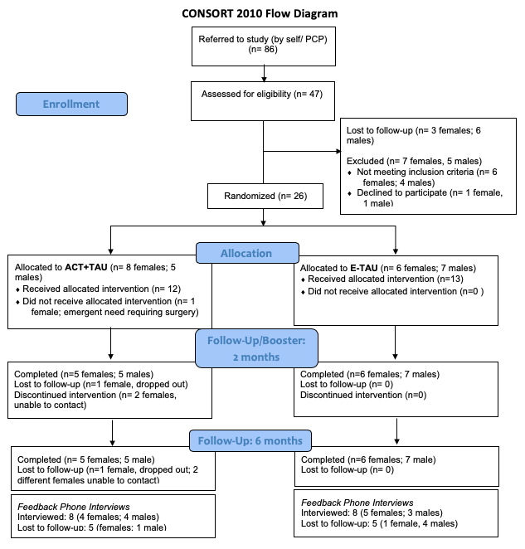
Notes:
Gender
Ethnicity

Slide 63
Results
@DrKatieK
Notes:
Want to present 2 ways of meaningfully looking at & understanding findings. All results interp w great caution due to small sample size...First, I’ll share the group means and changes over time.. Although inferential statistics are not of primary interest at this research phase, we did conduct mixed model analyses. Despite being underpowered …

Slide 64
Demographic | Categories | Percentage
GENDER | Female | 53.8%
 | Male | 46.2%
ETHNICIITY | Hispanic/Latino | 46%
 | Non-Hispanic/Non-Latino | 54%
RACE | White/Caucasian | 85%
 | Other | 11%
 | Asian | 4%
RELATIONSHIP | Married/living with partner | 69%
 | Single or widowed | 19%
 | In a relationship | 11.5%
EDUCATION | GED/High School | 15.3%
 | College/Associate’s | 26.9%
 | 4-year College Degree | 34.6%
 | Master’s Degree | 23.1%
HOUSEHOLD INCOME | <$20,000 | 15.4%
 | $20,000-50,000 | 42.3%
 | $45,000-100,000 | 23.1%
 | >$100,000 | 19.2%
N=26
Chronicity pain
Average 11.9 years
Range 0.25 - 51 years
Pain Intensity 2 Weeks (0-10)
Average 6.8/10
Range 3-10
Age
Average 52 years
Range 26-79 years
Notes:
Hispanic/Latino slightly under-represented compared to demographics in city of SA… commercial clinic – relatively high education/SES

Slide 65
No participants scored “at risk” for opioid misuse at baseline
Notes:
validated Prescription Drug Use Questionnaire-self report²
There were no significant differences nor relationships between groups on pain medications, hx of mental health dx, disability status, current pain intensity, chronic pain duration nor on gender/ethnicity/marital status/education/race/employment type
Current ways of categorizing pain… Nociceptive – there has been an injury and pain is a direct response to tissue damage… Neuroplastic – this is the new term being used to describe “central pain processing”; (e.g., FMS)… Neuropathic – nerve pain

Slide 66
Physical Disability (Primary Outcome)
d=0.06
ODI Scores
d=0.32
*
d=0.20
*
*
d=0.27
d=0.38
Lower scores = Less disability (good)
Notes:
Note: zoomed in for better visual inspection;
General linear mixed regression models with repeated measures were conducted and found that physical disability significantly improved in the FACT arm from pre-post at 12 weeks (p=0.002) and at 6 months (p=0.023). The E-TAU group also showed significant improvement from baseline to 12 weeks (p=0.003), but not at 6 months (p=0.546). Differences between groups were not significant after treatment at12 weeks (p=0.675) or at 6 month follow-up (p=0.196).
There was a small-medium effect size in the FACT arm in pre-post disability scores at post-treatment (12 weeks), d=0.38 (95% CL, 0.15 - 0.62) with some decrease at follow-up (24 weeks), d=0.27 (95% CL, 0.04 - 0.49). Effect sizes in the E-TAU arm post-treatment was small-medium d=0.32 (95% CL, 0.11 - 0.52) and at follow-up there was a miniscule effect at d=0.06 (95% CL, 0.14 - 0.27). Effect sizes between arms at post-treatment was trivial [d=0.07 (95% CL, -0.25 - 0.38)], but at follow-up, the effect size had increased to “small” at d=0.20 (95% CL, 0.11 - 0.51).

Slide 67
Chronic Pain Acceptance (Mechanistic)
d=0.35
*
CPAQ Scores
d=0.11
*
d=0.63
d=0.35
d=0.23
*
d=0.28
Higher scores = Greater acceptance (good)
Notes:
Findings from general linear mixed regression models with repeated measures indicated that chronic pain acceptance increased from pre-post treatment (12 weeks) for the FACT group and decreased for the control group, but these changes were not significant (p=0.51 and p=0.147). However, by follow-up (24 weeks), the FACT arm evidenced a significant increase in chronic pain acceptance from baseline (p=0.49) and the ETAU arm experienced a significant decrease (p=0.082); the differences between the groups was significant (0.009).
There was a minimal effect size in the FACT arm in pre-post chronic pain acceptance at post-treatment (12 weeks), d=0.11 (95% CL, -0.23 - 0.46) with a small-medium effect size at follow-up (24 weeks), d=0.35 (95% CL, 0.00 - 0.69). Effect size for decreased chronic pain acceptance in the E-TAU arm post-treatment was small d=0.23 (95% CL, 0.08 - 0.55) and at follow-up there continued to be a small effect at d=0.28 (95% CL, 0.04 - 0.60). Effect sizes for chronic pain acceptance between arms at post-treatment was small-medium [d=0.35 (95% CL, -0.12 - 0.82)], but at follow-up, the effect size increased to medium-large at d=0.63 (95% CL, 0.16 – 1.10).

Slide 68
Discrepancy Between Importance and Success in Valued Activities (Mechanistic)
CPVI Scores
d=0.51
*
d=0.94
*
d=0.25
d=0.20
*
d=0.76
*
d=1.14
Lower scores = Less discrepancy (good)
Notes:
the discrepancy significantly decreased in the FACT arm from pre-post treatment (12 weeks=.0003) and at follow-up (24 weeks; p=0.013); the differences between groups was not significant (p=.634). The E-TAU group also evidenced significantly decreased discrepancy scores at post-treatment (p=0.0009) and follow-up (p=0.044). Differences between the groups at follow-up was not significant (p=0.545).
There was a large effect size in the FACT arm in pre-post discrepancy scores at post-treatment (12 weeks), d=0.1.14 (95% CL, 0.54 – 1.74) and medium-large at follow-up (24 weeks), d=0.76 (95% CL, 0.16 – 1.36). Effect size for pre-post discrepancy scores in the E-TAU arm at post-treatment was also large, d=0.94 (95% CL, 0.39 – 1.49), with a medium effect size at follow-up, d=0.51 (95% CL, -0.04 – 1.06). Effect sizes for discrepancy scores between arms was small at post-treatment [d=0.20 (95% CL, -1.01 -0.62)] and at follow-up [d=0.25 (95% CL, -1.06 - 0.56)].

Slide 69
Acceptability (n=16)
Likert Scale Ratings
100% would recommend
60% satisfied
86% satisfied
86% would recommend
Range 1-7
Range 4-7
Range 6-7
Range 2-7
Notes:
4. Overall, how satisfied are you with this treatment? (Not satisfied at all, neutral, Very Satisfied)
5. How likely would you be to recommend this treatment to a friend or family member? (Would not … Would definitely recommend )

Slide 70
Feasibility of FACT & Pilot
Fidelity: 10% of audio recordings reviewed by external consultant & rated 100% for fidelity
Recruitment: 43% of goal ☹
Retention:
  Before intervention: -1 FACT participant
  During intervention: NO drop-outs in either arm
  At Booster visit: -2 FACT participants
  At 6-mo f/u assessment: 83% FACT & 100% E-TAU participants

Slide 71
Results: Qualitative Findings
@DrKatieK

Slide 72
Best/Most Likable Features of FACT
Learned to live with pain
  The matrix – quite often, they [classes] were educational and revealing – about how I was thinking about handling the pain..
Small group
  Like that it was just 2 people in the class—more intimate/ personalized/ customized
Mindfulness/meditation
  Trying to focus on other things other than the pain – breathe, meditate, all of it.

Slide 73
Worst/most disliked features
Paperwork and measures
  Filling out the forms every time
Wanted greater dose
  I wish I could have done more sessions. Need more practicing, more sessions.
Nothing
  There wasn’t really anything I disliked… it was good, the mental learning as well as doing
Notes:
.

Slide 74
Changes in how think about or manage pain
Changed relationship with pain/how handle pain
  I know that pain isn’t always going to stop,... you can learn to live with it using techniques..... mind is a powerful thing, so if you can help your mind to believe it, you can do.
Hope
  There is a next chapter…this wont go on forever… there are things I can do besides quit or give in.

Slide 75

Ways quality of life improved as a result of the changes made
Changed perspective
  I was able to stop dwelling on pain and stop being sorry for myself, was able to look at things clearer
Acquisition of tools to help live with pain
  [mindfulness] Helped me get rid of the thought process I was in

Slide 76
Conclusions
Key Findings of pilot study
Limitations/Challenges
4.5 hours of FACT delivered by BHC in primary care was:
  Acceptable and (mostly) feasible
  Effective in reducing physical disability
FACT acted on hypothesized mechanisms of change - acceptance and valued activities
  Significant between-group difference in acceptance
No dropouts during intervention phase
Small N
Real-world clinic setting
  Balancing scientific rigor with clinical care
  Recruitment challenges (feasibility)
  RCT maybe the wrong design
Small groups were a downside?
Subjective measures of functioning
Future Directions
Refine/modify → Larger (more pragmatic) trial
Group visits to 1:1 BHC visits
Adapt for underserved primary care populations
Task-shifting FACT to community health workers
Notes:
Other studies of brief ACT interventions tend to be several more hours than 3.5 with 1 hour booster
Some elements of a pragmatic trial; Balance/trade-offs… concurrent tx allowed; Pilot established preliminary data to support larger trial

Slide 77
Acknowledgements
Many thanks to my co-authors and entire study team
Patricia Robinson, PhD, Mountainview Consulting Group
Donald D. McGeary, PhD, ABPP, UT Health San Antonio
Willie J. Hale, PhD, University of Texas at San Antonio
Erin Finley, PhD, MPH, UT Health San Antonio & South Texas Veterans Health Care System
Cindy McGeary, PhD, ABPP, UT Health San Antonio
Jacqueline Pugh, MD, UT Health San Antonio & South Texas Veterans Health Care System
Mariana Munante, MD, UT Health San Antonio
Eliot Lopez, PhD, Psychiatry, UT Health San Antonio
Jim Mintz, PhD, UT Health San Antonio
Alex Carrizales, BA, UT Health San Antonio
Jennifer Potter, PhD, UT Health San Antonio
Don Dougherty, PhD, UT Health San Antonio
Dawn I. Velligan, PhD, UT Health San Antonio

Slide 78
Thank you!
Kathryn E. Kanzler, PsyD, ABPP
Kanzler@UTHSCSA.edu
@DrKatieK

Slide 79
Supplemental slides…

Slide 80
More about the FACT interventions
BHC Visit (1:1, 30 mins)
Functional assessment; biopsychosocial model of pain; intro to ACT pain matrix
Class A: Values & Action
Defusion; values clarification; connecting with others
Class B: Openness & Acceptance skills
STEM & DOTS techniques; Reducing avoidance; mindful breathing
Class C: Engagement skills
- Committed Action - setting SMARTER goals; value-based life goals
Booster: Maintaining progress
- Review; identifying barriers; using self-compassion to cope with relapses
**Feedback given to PCPs after each visit**
Notes:
Focus on Values
Identification of/commitment to
Reduce avoidance coping
Decrease unhelpful pain control strategies
Build awareness
Practice mindfulness skills
Engage in life
Set meaningful goals
→ How to live life in a meaningful way (even with pain

Slide 81
Class description
Structure
Content
Introductions & reinforcement
Review of between-class exercises
In-class activities/exercises
Didactic teaching
Homework/between-class exercises assignments
The ACT Matrix as a framework
Values as guide (Bullseye)
Defusion exercises
Acceptance of pain
Mindfulness and/or SNS calming practices
Focus on self-compassion
Committed action
Pain and Quality of Life Pathway program manual (Robinson & Kanzler, 2017).

Slide 82
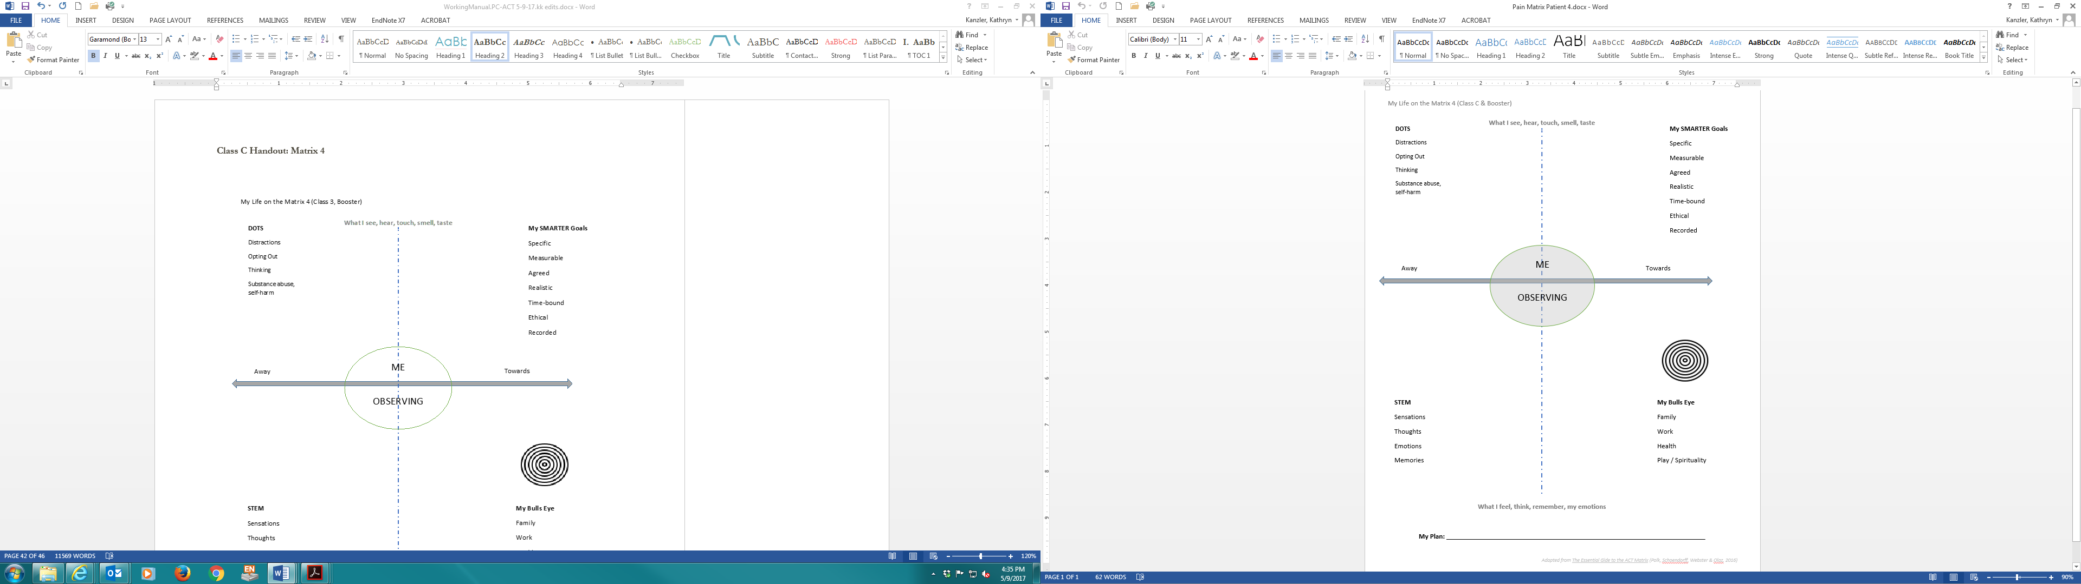
Example patient handout

Slide 83
fACT in Primary Care with High Risk Patients
Stacy Ogbeide, PsyD, ABPP
Associate Professor/Clinical
Dept. of Family & Community Medicine
Long School of Medicine

Slide 84
Presence of Behavioral Health Issues in Primary Care
84% of the time, the 14 most common physical complaints have no identifiable organic etiology¹
80% of individuals with a behavioral health disorder will visit primary care at least 1 time in a calendar year²
50% of all behavioral health disorders are treated in primary care³
20-40% of primary care patients have behavioral health needs⁴
48% of the appointments for all psychotropic agents are with a non-psychiatric primary care provider⁵
Sources: ¹Kroenke & Mangelsdorf, Am J Med. 1989;86:262-266. ²Narrow et al., Arch Gen Psychiatry. 1993;50:5-107. ³Kessler et al., NEJM. 2006;353:2515-23. ⁴Martin et al., Lancet. 2007; 370:859-877. ⁵Pincus et al., JAMA. 1998;279:526-531.

Slide 85
Presence of Suicidality in Primary Care
Almost 50% of individuals who die by suicide had contact with their primary care provider in the month preceding their death
15% saw a mental health provider
1-10% of primary care patients report thoughts of self-harm at any given time
Hunter, C., Goodie, J., Oordt, M., & Dobmeyer, A. (2017). Integrated Behavioral Health in Primary Care: Step-by-Step Guidance for Assessment and Intervention (2nd ed.). Washington, DC: American Psychological Association.

Slide 86
Suicidality in Primary Care
4 Principles for addressing suicide risk in primary care
1) Clinical approach must be consistent with primary care (not using techniques seen in specialty mental health settings)
2) Consistent with consultation model
3) Approach must be informed by clinical data
4) Clinical competency by BHC
Hunter, C., Goodie, J., Oordt, M., & Dobmeyer, A. (2017). Integrated Behavioral Health in Primary Care: Step-by-Step Guidance for Assessment and Intervention (2nd ed.). Washington, DC: American Psychological Association.

Slide 87
fACT in Primary Care
With continued growth of integrating behavioral health in primary care, need for more evidenced-informed intervention options
Dearth of evidence-informed behavioral interventions that fit into the context of primary care
Interventions need to maximize impact – meet a population health approach
Transdiagnostic and stepped care approach
fACT can meet this need…
Glover, N. G., Sylvers, P. D., Shearer, E. M., Kane, M.-C., Clasen, P. C., Epler, A. J., Plumb-Vilardaga, J. C., Bonow, J. T., & Jakupcak, M. (2016). The efficacy of Focused Acceptance and Commitment Therapy in VA primary care. Psychological Services, 13(2), 156–161. https://doi.org/10.1037/ser0000062

Slide 88
Case Example
L:
  White male patient in mid 20s
  Single; no children (recently ended dating relationship)
  “Good” family support (divorced when pt was in late adolescence)
  “Good” social support (less time with friends due to depressive sxs)
W:
  Works full-time in sales – describes work as a “good challenge”
  Denies food insecurity
P:
  Enjoy reading and playing sports (plays in rec leagues)
  Denies spiritual life
Health Behaviors:
  Denies current TAD (misused ETOH in the past – binge drinking); stopped use for the past 8 months – reports intrusive thoughts about suicidality increase when he drinks heavily)
  Three meals/daily
  Not sexually active
  Exercises 4 days/week (cardio/playing sports)
  Reports sleep as “good” (8 hours/night)
  Was on citalopram – stopped after 2 days (felt “weird)

Slide 89
Case Example – Cont’d
3Ts:
Pt reports depression/anxiety began at age 18 (after divorce; was also kicked out of college at this time for underaged drinking
Pt reports recurrent episodes of depression since 18 years of age; sxs currently in partial remission
Has CBT/psychotherapy in the past (good insight abt sx presentation)
Recent change: ending of a relationship (felt rejected)
What makes sxs worse: ETOH and rumination
Better: playing sports/exercise
Impact on LWP: moderate (worries he will have difficulty developing healthy relationship/friendships)

Slide 90
Case Example – Cont’d
Suicidality/Intrusive Thoughts:
Pt reports a period of consistent intrusive suicidal thoughts for three years (intensity stopped 8 months ago when ETOH use stopped)
Pt experiences different types of intrusive thoughts (stabbing self with knife, walking into traffic)
Pt denies past suicide attempts

Slide 91
Case Example – Cont’d
Visit | Intervention | Outcome Tools | HW | Suicidality
1 | Psycho-Ed; Intro to fACT | PHQ-9: 5 GAD-7: 2 Q-LES-SF: 38 AAQ2: 24 | Suffering inventory and identifying painful thoughts that he is fused to; identifying values | Reporting intrusive thoughts (Strength = 10)
2 | Self-compassion exercise; STEM | PHQ-9: 6 GAD-7: 4 Q-LES-SF: 36 AAQ2: 26 | identifying painful thoughts that he is fused to; identifying value-driven bxs | Reporting intrusive thoughts (Strength = 9)
3 | Examples of experiential avoidance | PHQ-9: 2 GAD-7: 1 Q-LES-SF: 44 AAQ2: 22 | Daily practice of self-compassion; taking opportunities to decrease avoidance of STEM and engaging in value-driven bx | Reporting intrusive thoughts (Strength = 7)
4 | Relational frames/power of language and experiential avoidance; cognitive defusion exercise; self-compassion | PHQ-9: 0 GAD-7: 2 Q-LES-SF: 45 AAQ2: 18 | Decreasing avoidance of STEM while engaging in value-driven bx; daily self-compassion practice | Reporting intrusive thoughts (Strength = 4)
Notes:
BHC and pt also discussed concept of willingness to experience STEM rather than ignoring/distracting oneself from STEM; Pt reported he was able to practice this with some success and will continue to do engage in "letting the thought (emotion, etc.) be there" rather than focusing on challenging the content of the thought (emotion, etc);

Slide 92
Case Example – Cont’d
Visit | Intervention | Outcome Tools | HW | Suicidality
5 | Cognitive defusion: practiced exercises during the visit ("buying the thought," "the mind"); Role of STEM with engaging in decisions consistent with values; concept of willingness to experience STEM | PHQ-9: 1 GAD-7: 1 Q-LES-SF: 42 AAQ2: 21 | Pt will continue daily practices to express self-compassion; Pt willing to select a defusion exercise to use daily when STEM shows up Will review book when needed: Get out of your mind and into your life | Reporting intrusive thoughts (Strength = 3)
Notes:
BHC and pt also discussed concept of willingness to experience STEM rather than ignoring/distracting oneself from STEM; Pt reported he was able to practice this with some success and will continue to do engage in "letting the thought (emotion, etc.) be there" rather than focusing on challenging the content of the thought (emotion, etc);

Slide 93
Summary
fACT effective in the context of primary care (practice management lens) for management of high-risk patients
More research needed – especially with low literacy/low health literacy populations
Impact of telehealth (COVID-19)

Slide 94
Thank you!
Questions?
Dr. Ogbeide: ogbeide@uthscsa.edu

Slide 95
Does Focused Acceptance and Commitment Therapy Move the Dial on Health Equity?
Patti Robinson, PhD
Consultant and Trainer
Mountainview Consulting Group
Portland, OR
Patti@mtnviewconsulting.com

Slide 96
Proof of Concept Study
Year 1: 5 general practice clinics in Auckland NZ
Year 2: Expansion to 12 practice sites, including rural areas
Study team:
  ProCare: Johnny O’Connell
  Consultants: Jo Chipman, Sue Hallwright, Patti Robinson
  HIPs

Slide 97



HIPs of New Zealand

Slide 98
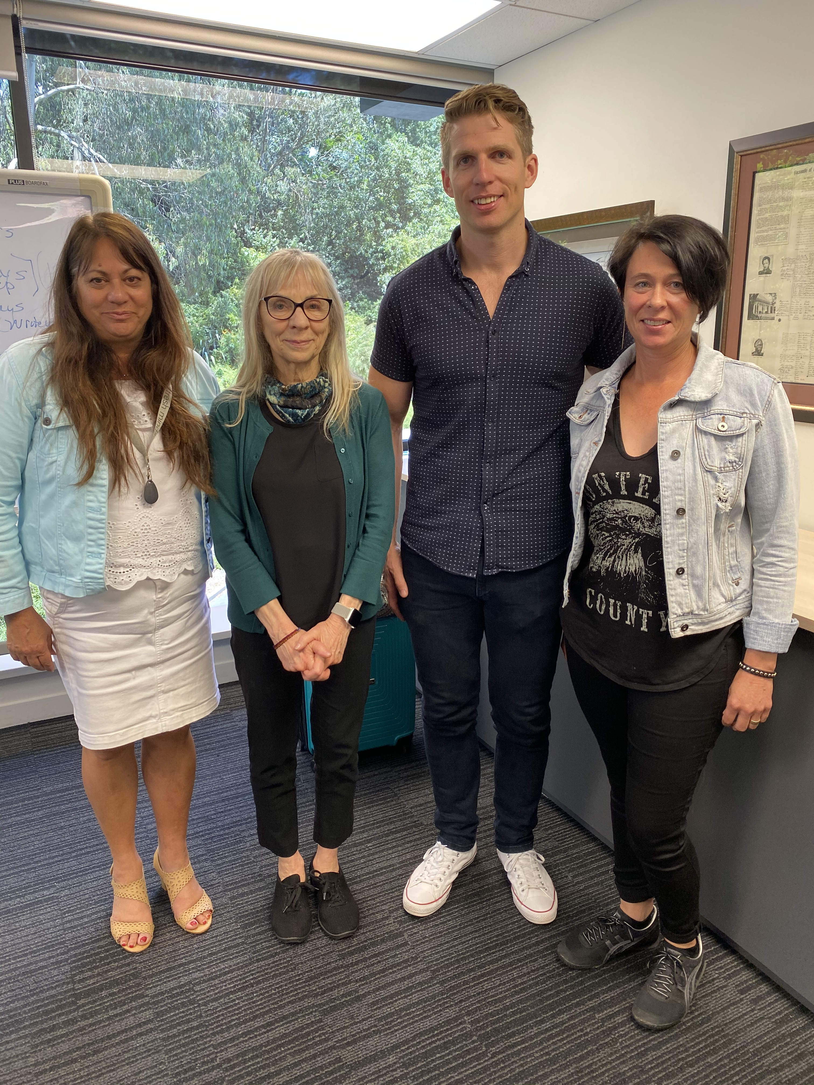

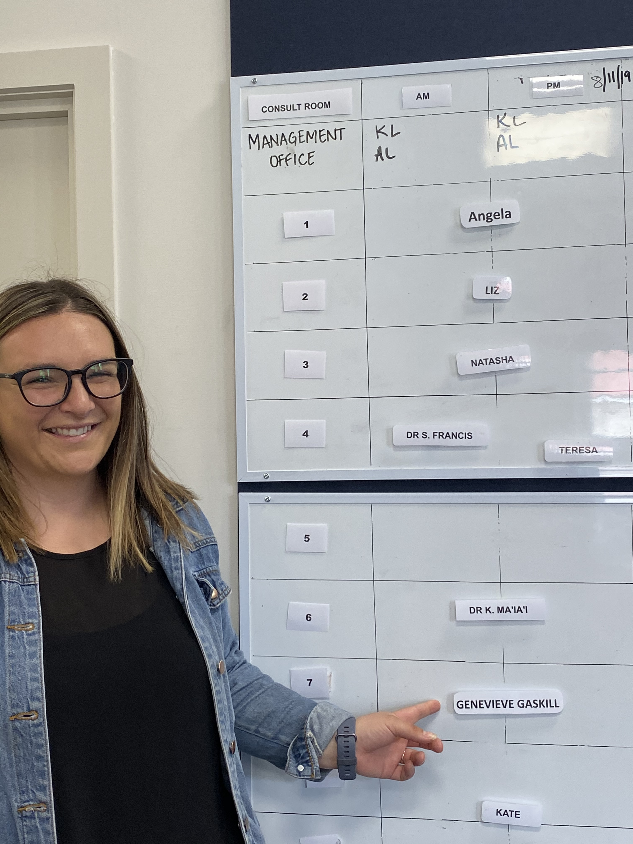
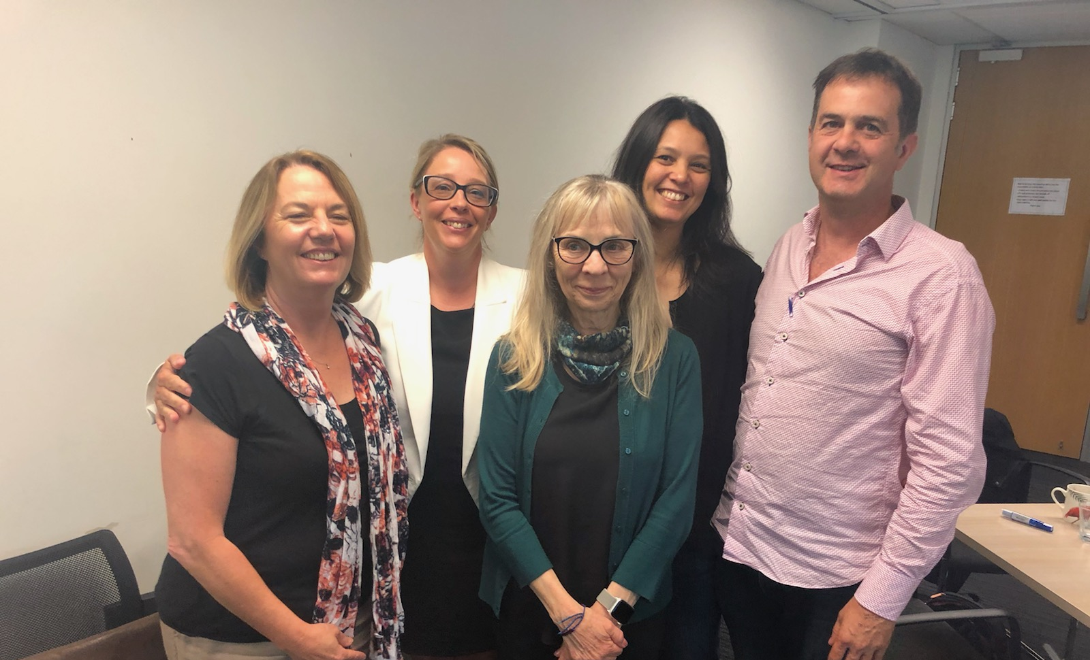
HIPs of New Zealand

Slide 99


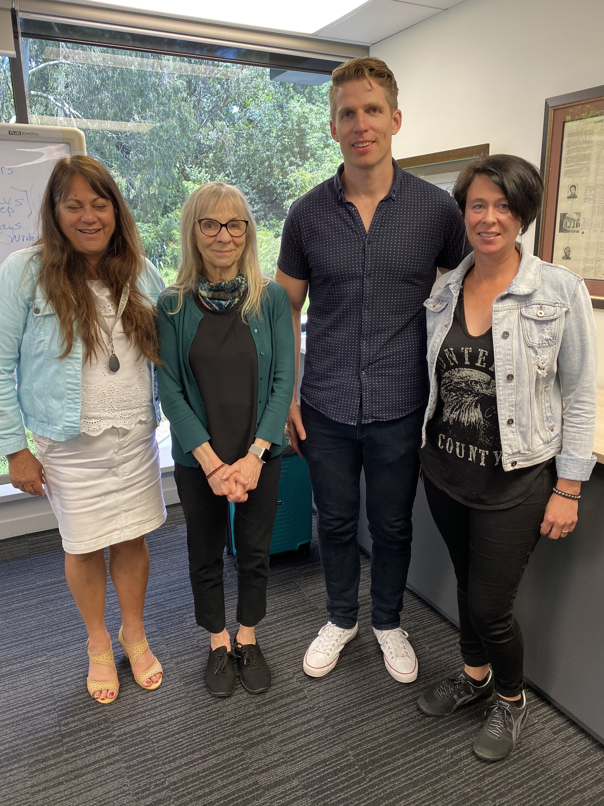
HIPs of New Zealand

Slide 100
Procedure
New staff hired and trained in Primary Care Behavioral Health (PCBH) and Focused Acceptance and Commitment Therapy (FACT)
  Health Improvement Practitioners (HIPs) participated in 4-day classroom training
  HIPs and practice colleagues learn PCBH and FACT in short didactic sessions and in the context of delivery of healthcare services 3-5 days over year one
  Data collected and reported back to HIPs on a monthly basis

Slide 101

PCBH / HIP as a GATHERer*
Generalist
Accessible
Team-based
High Productivity
Educator
Routine care component
*Robinson & Reiter, 2016. Behavioral Consultation and Primary Care: A Guide to Integrating Services, 2nd Edition
Notes:
The areas in white are where Family Therapists can have a direct influence in this movement.
Payment is also underlined because of how we consider the value and worth of our profession in the future.
“Despite our common history with family medicine, family therapy has more or less been cut off from this discipline. However, the core of family physicians is rooted in trust, relationships, and a life-long relationships. The language Family physicians use to describe patient care as well as the type of relationship they aspire to have are language and skills very familiar to the trained family therapist. Let’s listen to one of it’s champions.”
Lets first talk about our common history with Family Medicine and then we will hear some thoughts from Dr. Rusty Kallenberg, former president of STFM, in one of his previous interviews.

Slide 102
FACT Tools Used in Training
Bulls-Eye Plan and Worksheet
Contextual Interview – Adult and Child / Youth
Four Square Tool
Life Path Plan Worksheet
Pain Matrix
Pillars Intervention Guide
Pillars Assessment Tool
Rating Scale Questions
Relate the Problem to Values Worksheet
SMART Behavioural Experiment Worksheet
Robinson, 2020. Basics of Behavior Change
in Primary Care. Springer

Slide 103
Data Included
HIP visits per day
% of HIP visits same-day of request (50% goal)
Reason for referral
Length of visit
Status at follow-up: same, better, worse
Helpfulness of HIP visit / patient satisfaction

Slide 104
HIP Services and Patient Access*
57 – 70% of patients seen by HIP on the same day as disclosing distress to their GP (compared to 3 – 5% for conventional service)
75% seen by HIP within five days (less than 17% in conventional services)
See http://www.tetumuwaiora.co.nz/#tetumuwaiora

Slide 105
HIP Services and Health Care Equity
Significantly improved equity of access across Māori, Pacific, Asian and European populations with no significant difference between rates of conversion of referral to appointments across ethnicities
74% of Māori clients reported improved wellbeing (compared to 72% European, 74% Asian, 71% overall)
95% satisfaction rating from over 3,000 patient surveys
Reduction in prescribing of medication in favour of a ‘skills before pills’ approach
See http://www.tetumuwaiora.co.nz/#tetumuwaiora

Slide 106
HIP Clients at Follow-Up: Better, Same, Worse
62%
24%

Slide 107
Other outcomes for people accessing HIPs
Improvements in the broader determinants of wellbeing, such as housing and money matters
Benefits also seen for youth
Emerging reductions in prescribing for antidepressants

Slide 108
Outcomes for professionals
Saves GP and nurse consult time
Efficiencies are supporting GPs and PNs to work at the top of scope
Give GP staff confidence to “have the conversation” about MH
Reduces referrals to psychological services
Improved collaboration across ADHB, WDHB and its partners

Slide 109
Questions, Comments
Use the chat box on the screen that you used to join this presentation
At the beginning of your question, indicate the name of the presenter you are directing your question to
Example: ”Dr. Barreto, how many….”

